Slide 1
Single Sample t-Test
Chad Williams
University of Victoria

Slide 2
Lecture Outline
Single Score versus Sample Mean
Single-Sample T-Test
Example

Slide 3
Lecture Outline
Single Score versus Sample Mean
Single-Sample T-Test
Example

Slide 4
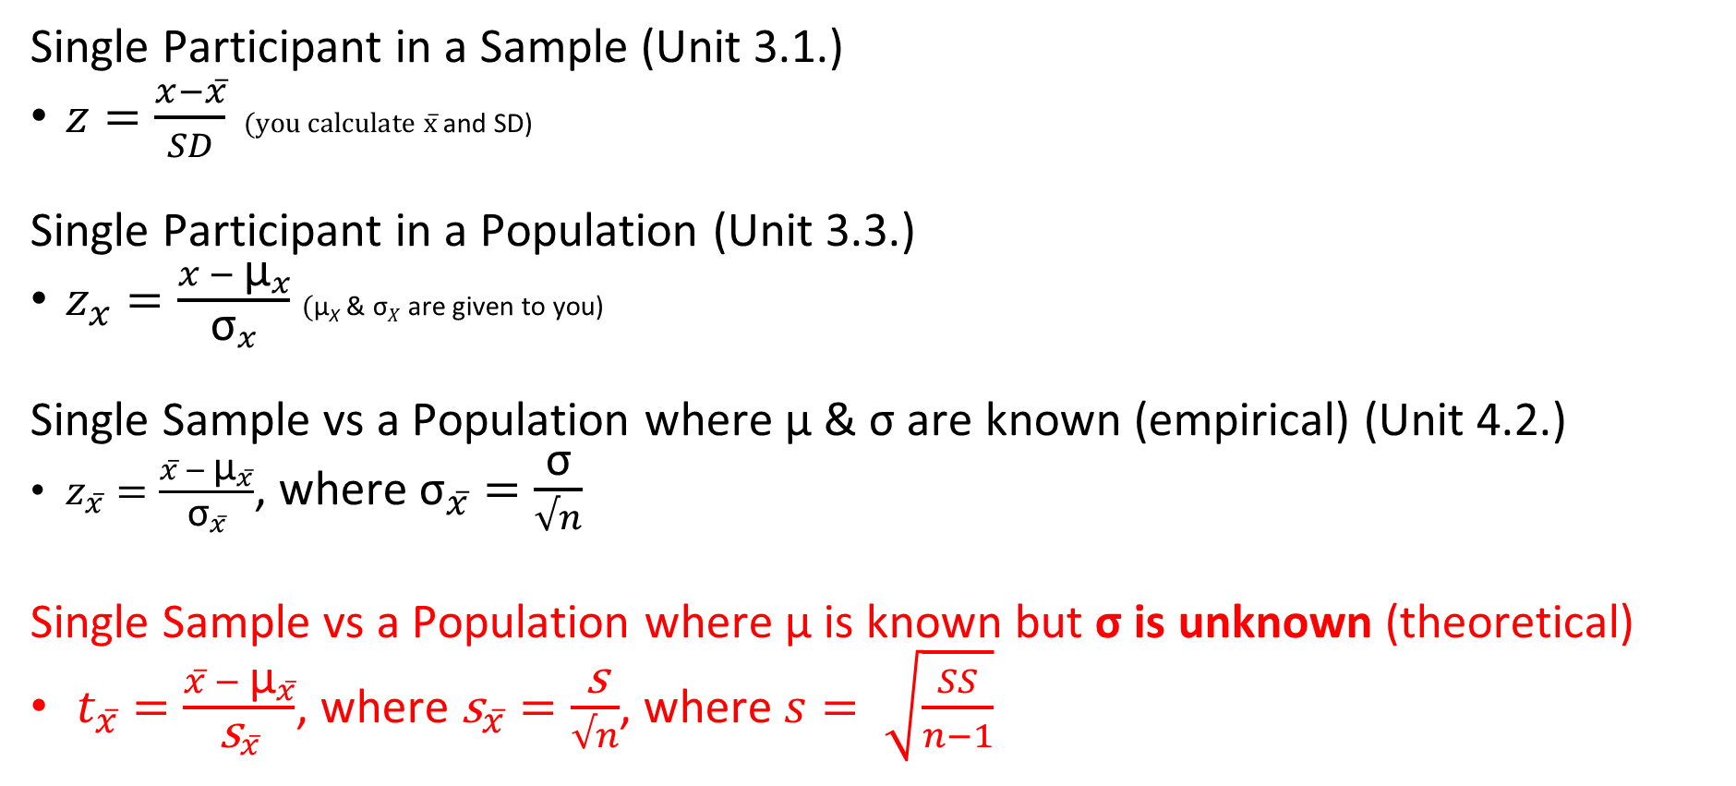
Single Participant vs Single Sample
Single Participant in a Sample (Unit 3.1.)
$z=\frac{x−x̅}{SD}$ $(\text{you} \text{calculate} \text{x}̅$and SD)
Single Participant in a Population (Unit 3.3.)
$z_{x}=\frac{x − {\text{μ}}_{x}}{{\text{σ}}_{x}}$ $(\text{μ}\text{X}$ & $\text{σ}X$ are given to you)
Single Sample vs a Population where $\text{μ} \text{\& }\text{σ}$ are known (empirical) (Unit 4.2.)
$z_{x̅}=\frac{x̅ − {\text{μ}}_{x̅}}{{\text{σ}}_{x̅}}$, where ${\text{σ}}_{x̅̅}=\frac{\text{σ}}{√n}$
Single Sample vs a Population where $\text{μ} \text{is} \text{known} \text{but} \text{σ}$ is unknown (theoretical)
$t_{x̅}=\frac{x̅ − {\text{μ}}_{x̅}}{{\text{s}}_{x̅}}$, where ${\text{s}}_{x̅̅}=\frac{\text{s}}{√n}$, where $s= \sqrt{\frac{SS}{n−1}}$

Slide 5
Estimating σ
When we know μ & σ (Z-Test)
The population is empirical
We can use the standard normal distribution as our sampling distribution of the mean (i.e., the z-table)
When σ is unknown (T-Test)
The population is theoretical
We must then estimate σ from our data, which varies depending on n
Instead of the standard normal distribution, we will use the family of curves (i.e., the t-tables)

Slide 6




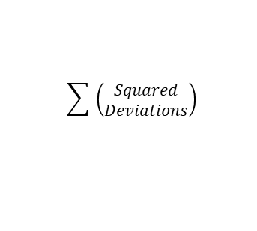

$$x − \bar{x}$$
$${deviations}^{2}$$
$$\sum{ \left(\begin{aligned}Squared \\ Deviations\end{aligned}\right)}$$
$$\frac{SS}{n}$$
$$\sqrt{{SD}^{2}}$$
$$\frac{x − \bar{x} }{SD}$$
Z-score
Table
X
Deviations
Squared
Deviations
Sum of Squares
(SS)
Variance
(SD²)
Standard
Deviation (SD)
Single Participant
Z-Score (Sample)
P-Value

Slide 7

$$x − \bar{x}$$
$${deviations}^{2}$$
$$\sum{ \left(\begin{aligned}Squared \\ Deviations\end{aligned}\right)}$$
$$\frac{SS}{n}$$
$$\sqrt{{SD}^{2}}$$
$$\frac{x − \bar{x} }{SD}$$
Z-score
Table
X
Deviations
Squared
Deviations
Sum of Squares
(SS)
Variance
(SD²)
Standard
Deviation (SD)
Single Participant
Z-Score (Sample)
P-Value
$$\frac{x − μ_{x}}{σ_{x}}$$
Z-score
Table
Single Participant
Z-Score (Population)
P-Value

Slide 8


$$\frac{\bar{x} − μ_{\bar{x}}}{σ_{\bar{x}}}$$
Z-score
Table
Standard Error
(σₓ̄)
Single Sample
Z-Score
P-Value
$$\frac{σ}{\sqrt{n}}$$
$$x − \bar{x}$$
$${deviations}^{2}$$
$$\sum{ \left(\begin{aligned}Squared \\ Deviations\end{aligned}\right)}$$
$$\frac{SS}{n}$$
$$\sqrt{{SD}^{2}}$$
$$\frac{x − \bar{x} }{SD}$$
Z-score
Table
X
Deviations
Squared
Deviations
Sum of Squares
(SS)
Variance
(SD²)
Standard
Deviation (SD)
Single Participant
Z-Score (Sample)
P-Value
$$\frac{x − μ_{x}}{σ_{x}}$$
Z-score
Table
P-Value
Single Participant
Z-Score (Population)

Slide 9




$$\frac{\bar{x} − μ_{\bar{x}}}{σ_{\bar{x}}}$$
Z-score
Table
$$\sqrt{s^{2}}$$
$$\frac{s}{\sqrt{n}}$$
$$\frac{\bar{x} − μ_{\bar{x}}}{s_{\bar{x}}}$$
t-score
Table
Standard Error
(σₓ̄)
P-Value
Variance
(s²)
Standard
Deviation (s)
P-Value
Single Sample
Z-Score
Standard Error
(s_{x̅})
Single Sample
t-Score
$$\frac{σ}{\sqrt{n}}$$
$$\frac{SS}{n − 1}$$
$$x − \bar{x}$$
$${deviations}^{2}$$
$$\sum{ \left(\begin{aligned}Squared \\ Deviations\end{aligned}\right)}$$
$$\frac{SS}{n}$$
$$\sqrt{{SD}^{2}}$$
$$\frac{x − \bar{x} }{SD}$$
Z-score
Table
X
Deviations
Squared
Deviations
Sum of Squares
(SS)
Variance
(SD²)
Standard
Deviation (SD)
Single Participant
Z-Score (Sample)
P-Value
$$\frac{x − μ_{x}}{σ_{x}}$$
Z-score
Table
P-Value
Single Participant
Z-Score (Population)

Slide 10






$$\frac{\bar{x} − μ_{\bar{x}}}{σ_{\bar{x}}}$$
Z-score
Table
$$\sqrt{s^{2}}$$
$$\frac{s}{\sqrt{n}}$$
$$\frac{\bar{x} − μ_{\bar{x}}}{s_{\bar{x}}}$$
t-score
Table
Standard Error
(σₓ̄)
Single Sample
Z-Score
Variance
(s²)
Standard
Deviation (s)
P-Value
P-Value
Standard Error
(s_{x̅})
Single Sample
t-Score
$$\frac{σ}{\sqrt{n}}$$
$$\frac{SS}{n − 1}$$
$$x − \bar{x}$$
$${deviations}^{2}$$
$$\sum{ \left(\begin{aligned}Squared \\ Deviations\end{aligned}\right)}$$
$$\frac{SS}{n}$$
$$\sqrt{{SD}^{2}}$$
$$\frac{x − \bar{x} }{SD}$$
Z-score
Table
X
Deviations
Squared
Deviations
Sum of Squares
(SS)
Variance
(SD²)
Standard
Deviation (SD)
Single Participant
Z-Score (Sample)
P-Value
$$\frac{x − μ_{x}}{σ_{x}}$$
Z-score
Table
Single Participant
Z-Score (Population)
P-Value

Slide 11
$$\frac{\bar{x} − μ_{\bar{x}}}{σ_{\bar{x}}}$$
Z-score
Table
$$\sqrt{s^{2}}$$
$$\frac{s}{\sqrt{n}}$$
$$\frac{\bar{x} − μ_{\bar{x}}}{s_{\bar{x}}}$$
t-score
Table
Standard Error
(σₓ̄)
P-Value
Variance
(s²)
Standard
Deviation (s)
P-Value
Single Sample
Z-Score
Standard Error
(s_{x̅})
Single Sample
t-Score
$$\frac{σ}{\sqrt{n}}$$
$$\frac{SS}{n − 1}$$
$$x − \bar{x}$$
$${deviations}^{2}$$
$$\sum{ \left(\begin{aligned}Squared \\ Deviations\end{aligned}\right)}$$
$$\frac{SS}{n}$$
$$\sqrt{{SD}^{2}}$$
$$\frac{x − \bar{x} }{SD}$$
Z-score
Table
X
Deviations
Squared
Deviations
Sum of Squares
(SS)
Variance
(SD²)
Standard
Deviation (SD)
Single Participant
Z-Score (Sample)
P-Value
$$\frac{x − μ_{x}}{σ_{x}}$$
Z-score
Table
P-Value
Single Participant
Z-Score (Population)

Slide 12
Lecture Outline
Single Score versus Sample Mean
Single-Sample T-Test
Example

Slide 13
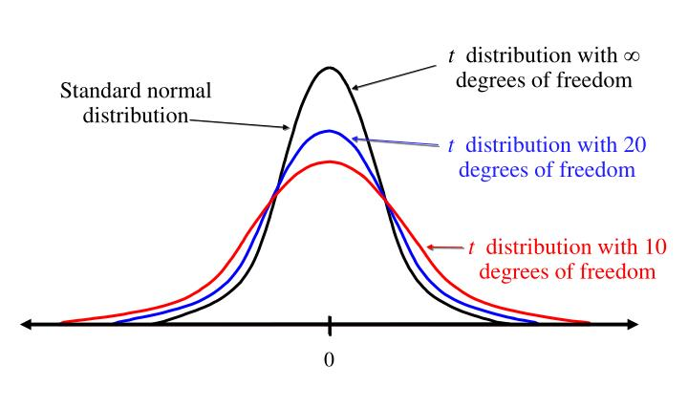
Assumptions of a T-Test
Assumptions are criteria that need to be met for a test to be applied:
Random sampling
DV is normally distributed in population
Data are scores
n ≥ 7

Slide 14

Step 1:
H₀: μ = 75.00
H₁: μ ≠ 75.00
Thus, two-tailed
Step 2:
Type of Research Design: Single-Sample Design
Model of Hypothesis Testing: Random Sampling
Nature of Data (Scales of measurement): Score data
Statistic Being Analyzed: x̅
Information about the Population: μ = 75.00, σ = unknown
Sample Size: n = 25
Shape: Normally distributed
Step 3:
p(α) = .05, t(crit) = 2.0639
Step 4:
t(obs) = $\frac{82.0000 −75.0000}{\text{2.4}\text{00}\text{0}}$ = 2.9167
p(obs) < .01
Step 5:
t(obs) = |2.9167| > t(crit) = |2.0639|
p(obs) < .01 < p(α) = .05
Reject the null, accept the alternative
Step 6:
The stats problem generator group’s final exam scores (x̅ = 82.00%, s = 12.00%, n = 25) were statistically higher than the average of the class (μ = 75.00%), t(24) = 2.92, p < .01. The problem generator increased the group’s exam score.

Slide 15

Step 1:
H₀: μ = 75.00
H₁: μ ≠ 75.00
Thus, two-tailed
Step 2:
Type of Research Design: Single-Sample Design
Model of Hypothesis Testing: Random Sampling
Nature of Data (Scales of measurement): Score data
Statistic Being Analyzed: x̅
Information about the Population: μ = 75.00, σ = unknown
Sample Size: n = 25
Shape: Normally distributed
Step 3:
p(α) = .05, t(crit) = 2.0639
Step 4:
t(obs) = $\frac{82.0000 −75.0000}{\text{2.4}\text{00}\text{0}}$ = 2.9167
p(obs) < .01
Step 5:
t(obs) = |2.9167| > t(crit) = |2.0639|
p(obs) < .01 < p(α) = .05
Reject the null, accept the alternative
Step 6:
The stats problem generator group’s final exam scores (x̅ = 82.00%, s = 12.00%, n = 25) were statistically higher than the average of the class (μ = 75.00%), t(24) = 2.92, p < .01. The problem generator increased the group’s exam score.

Slide 16
Step 1 – No Changes
 | Single Participant Design | Single Sample Design (parameters known) | Single Sample Design (σ unknown)
Non-Directional | H₀: μ = 75.00 H₁: μ ≠ 75.00 | H₀: μ = 75.00 H₁: μ ≠ 75.00 | H₀: μ = 75.00 H₁: μ ≠ 75.00
Directional | H₀: μ ≤ 75.00 H₁: μ > 75.00 H₀: μ ≥ 75.00 H₁: μ < 75.00 | H₀: μ ≤ 75.00 H₁: μ > 75.00 H₀: μ ≥ 75.00 H₁: μ < 75.00 | H₀: μ ≤ 75.00 H₁: μ > 75.00 H₀: μ ≥ 75.00 H₁: μ < 75.00

Slide 17
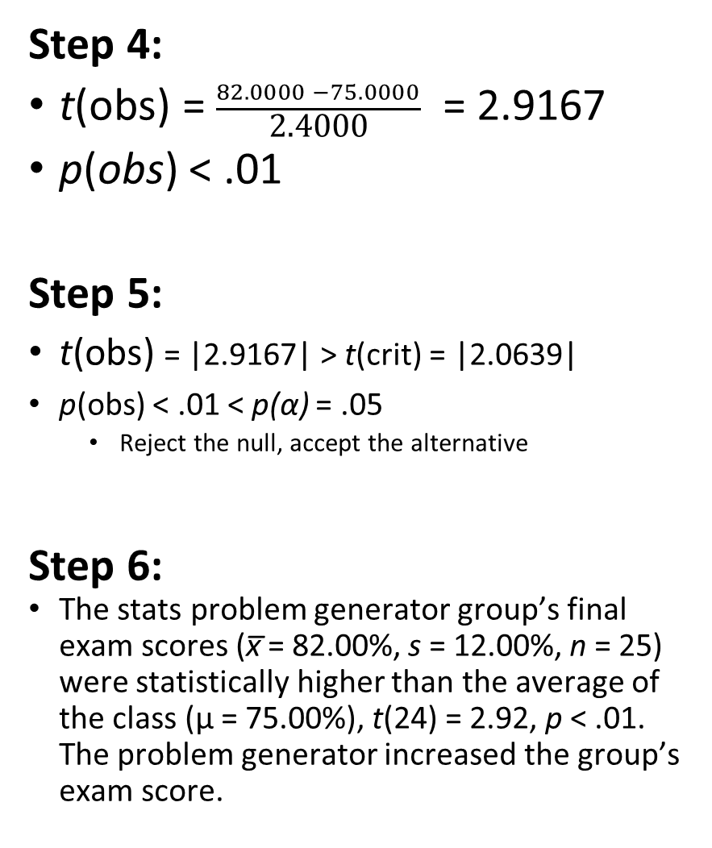
Step 1:
H₀: μ = 75.00
H₁: μ ≠ 75.00
Thus, two-tailed
Step 2:
Type of Research Design: Single-Sample Design
Model of Hypothesis Testing: Random Sampling
Nature of Data (Scales of measurement): Score data
Statistic Being Analyzed: x̅
Information about the Population: μ = 75.00, σ = unknown
Sample Size: n = 25
Shape: Normally distributed
Step 3:
p(α) = .05, t(crit) = 2.0639
Step 4:
t(obs) = $\frac{82.0000 −75.0000}{\text{2.4}\text{00}\text{0}}$ = 2.9167
p(obs) < .01
Step 5:
t(obs) = |2.9167| > t(crit) = |2.0639|
p(obs) < .01 < p(α) = .05
Reject the null, accept the alternative
Step 6:
The stats problem generator group’s final exam scores (x̅ = 82.00%, s = 12.00%, n = 25) were statistically higher than the average of the class (μ = 75.00%), t(24) = 2.92, p < .01. The problem generator increased the group’s exam score.

Slide 18
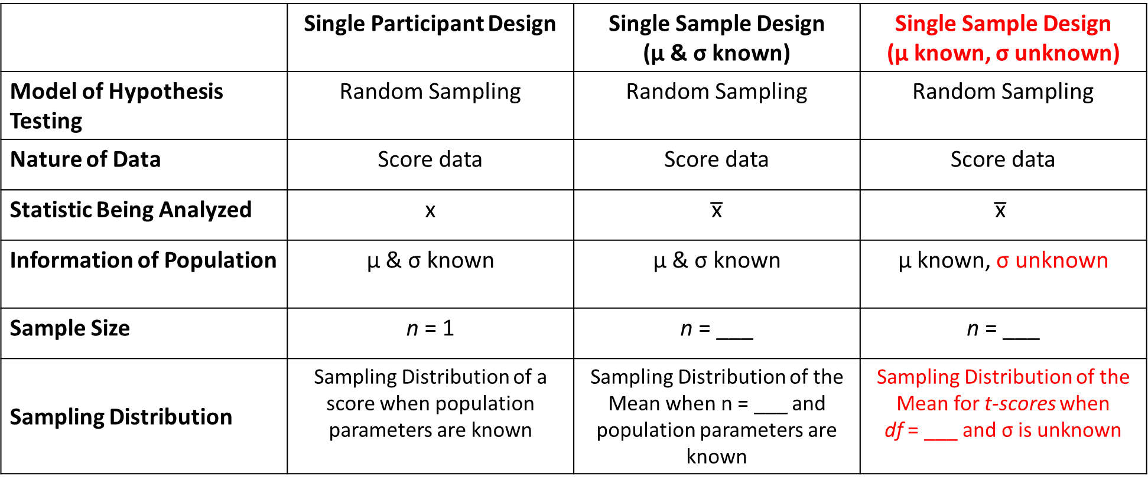
Step 2 - Changes
 | Single Participant Design | Single Sample Design (μ & σ known) | Single Sample Design (μ known, σ unknown)
Model of Hypothesis Testing | Random Sampling | Random Sampling | Random Sampling
Nature of Data | Score data | Score data | Score data
Statistic Being Analyzed | x | x̅ | $$\text{x}\text{̅}$$
Information of Population | μ & σ known | μ & σ known | μ known, σ unknown
Sample Size | n = 1 | n = ___ | n = ___
Sampling Distribution | Sampling Distribution of a score when population parameters are known | Sampling Distribution of the Mean when n = ___ and population parameters are known | Sampling Distribution of the Mean for t-scores when df = ___ and σ is unknown

Slide 19
Step 1:
H₀: μ = 75.00
H₁: μ ≠ 75.00
Thus, two-tailed
Step 2:
Type of Research Design: Single-Sample Design
Model of Hypothesis Testing: Random Sampling
Nature of Data (Scales of measurement): Score data
Statistic Being Analyzed: x̅
Information about the Population: μ = 75.00, σ = unknown
Sample Size: n = 25
Shape: Normally distributed
Step 3:
p(α) = .05, t(crit) = 2.0639
Step 4:
t(obs) = $\frac{82.0000 −75.0000}{\text{2.4}\text{00}\text{0}}$ = 2.9167
p(obs) < .01
Step 5:
t(obs) = |2.9167| > t(crit) = |2.0639|
p(obs) < .01 < p(α) = .05
Reject the null, accept the alternative
Step 6:
The stats problem generator group’s final exam scores (x̅ = 82.00%, s = 12.00%, n = 25) were statistically higher than the average of the class (μ = 75.00%), t(24) = 2.92, p < .01. The problem generator increased the group’s exam score.

Slide 20
Step 3 - Changes
Changes to step 3
z(crit) becomes t(crit)
But the t(crit) will change for each degrees of freedom (df)
We will see degrees of freedom equals n-1, so it changes for each n
Thus, we need a different table for each degrees of freedom

Slide 21
Step 3 - Changes
Sampling Distributions
The family of curves reflects a series of different sampling distributions, each specific to a certain df
At small df, dist is platykurtic
At large df, dist is mesokurtic
Becomes the same as the standard normal distribution (z-table) at high df

Slide 22
Step 3 - Changes

Slide 23
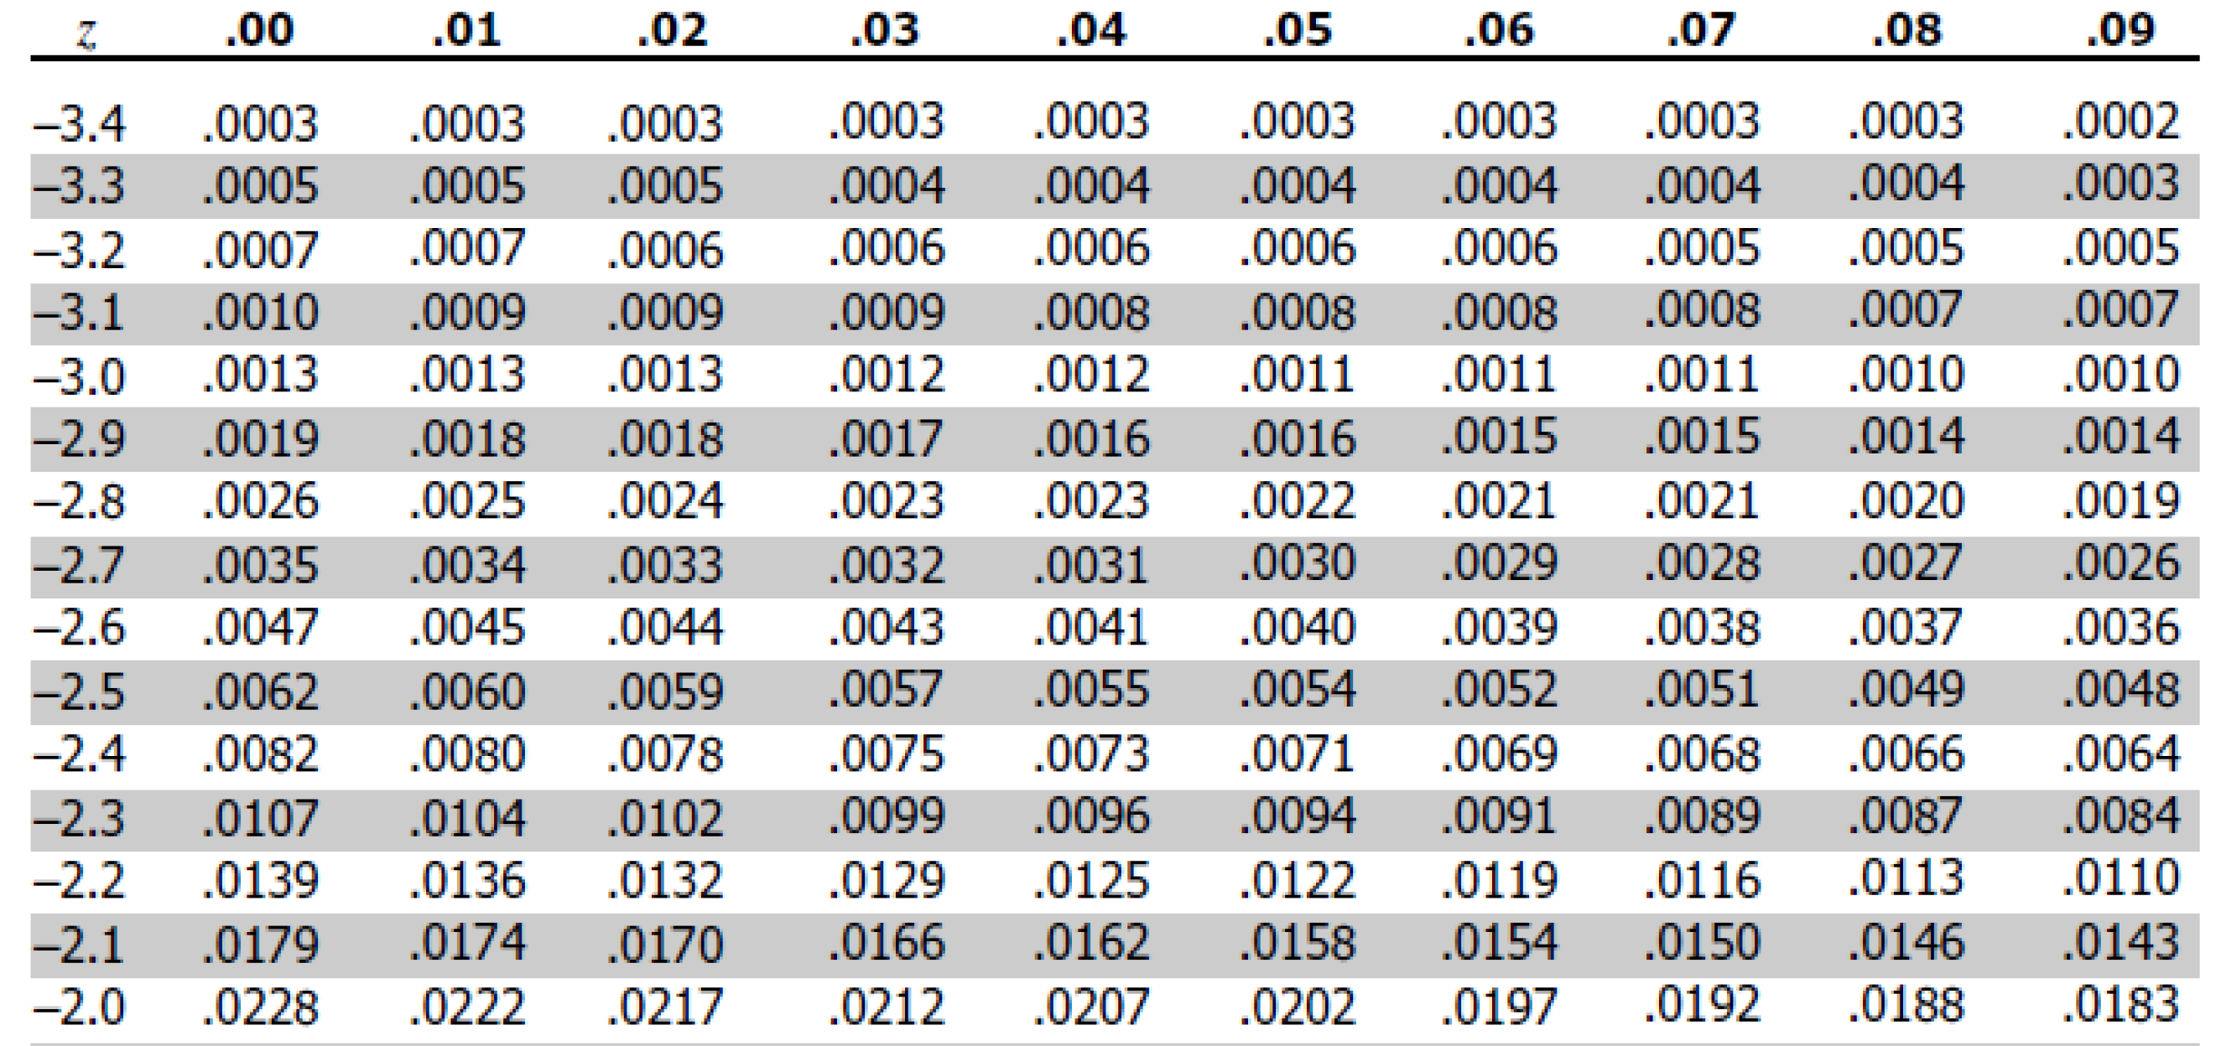
Step 3 - Changes
z-scores on the outside
p-values on the top
df on the left
Z-Table
T-Table
p-values on the inside
t-scores on the inside

Slide 24
Step 3 - Changes
p(α) = .05_{two-tailed}
df = n-1
e.g., if n = 10, df = 10 - 1 = 9
t(crit) = 2.2622

Slide 25
Step 3 - Changes
p(α) = .05_{one-tailed}
df = n-1
e.g., if n = 10, df = 10 - 1 = 9
t(crit) = 1.8331

Slide 26
Step 1:
H₀: μ = 75.00
H₁: μ ≠ 75.00
Thus, two-tailed
Step 2:
Type of Research Design: Single-Sample Design
Model of Hypothesis Testing: Random Sampling
Nature of Data (Scales of measurement): Score data
Statistic Being Analyzed: x̅
Information about the Population: μ = 75.00, σ = unknown
Sample Size: n = 25
Shape: Normally distributed
Step 3:
p(α) = .05, t(crit) = 2.0639
Step 4:
t(obs) = $\frac{82.0000 −75.0000}{\text{2.4}\text{00}\text{0}}$ = 2.9167
p(obs) < .01
Step 5:
t(obs) = |2.9167| > t(crit) = |2.0639|
p(obs) < .01 < p(α) = .05
Reject the null, accept the alternative
Step 6:
The stats problem generator group’s final exam scores (x̅ = 82.00%, s = 12.00%, n = 25) were statistically higher than the average of the class (μ = 75.00%), t(24) = 2.92, p < .01. The problem generator increased the group’s exam score.

Slide 27
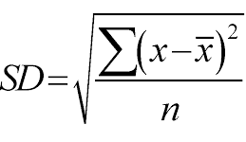
Step 4 - Changes
We know standard deviation (SD) as:
We’re now going to use standard deviation to estimate σ
But it underestimates it
So, we will now compute standard deviation (s) as:
Degrees of Freedom (df; n-1): df is a correction to our equation so that it no longer underestimates σ
We correct it by the number of parameters we are estimating (here σ)
- 1

Slide 28

Step 4 - Changes
New Test Ratio: $t_{x̅}=\frac{x̅ − {\text{μ}}_{x̅}}{{\text{s}}_{x̅}}$
where ${\text{s}}_{x̅̅}=\frac{\text{s}}{√n}$
where s = $\sqrt{\frac{SS}{n−1}}$ OR $\sqrt{\frac{∑{(x − x̅)}^{2}}{n − 1}}$

Slide 29

$$\frac{\bar{x} − μ_{\bar{x}}}{σ_{\bar{x}}}$$
Z-score
Table
$$\sqrt{s^{2}}$$
$$\frac{s}{\sqrt{n}}$$
$$\frac{\bar{x} − μ_{\bar{x}}}{s_{\bar{x}}}$$
t-score
Table
Standard Error
(σₓ̄)
Single Sample
Z-Score
Variance
(s²)
Standard
Deviation (s)
P-Value
P-Value
Standard Error
(s_{x̅})
Single Sample
t-Score
$$\frac{σ}{\sqrt{n}}$$
$$\frac{SS}{n − 1}$$
$$x − \bar{x}$$
$${deviations}^{2}$$
$$\sum{ \left(\begin{aligned}Squared \\ Deviations\end{aligned}\right)}$$
$$\frac{SS}{n}$$
$$\sqrt{{SD}^{2}}$$
$$\frac{x − \bar{x} }{SD}$$
Z-score
Table
X
Deviations
Squared
Deviations
Sum of Squares
(SS)
Variance
(SD²)
Standard
Deviation (SD)
Single Participant
Z-Score (Sample)
P-Value
$$\frac{x − μ_{x}}{σ_{x}}$$
New Test Ratio: $t_{x̅}=\frac{x̅ − {\text{μ}}_{x̅}}{{\text{s}}_{x̅}}$
where ${\text{s}}_{x̅̅}=\frac{\text{s}}{√n}$
where s = $\sqrt{\frac{SS}{n−1}}$ OR $\sqrt{\frac{∑{(x − x̅)}^{2}}{n − 1}}$
Z-score
Table
Single Participant
Z-Score (Population)
P-Value

Slide 30
Step 4 - Changes
p-Value: Now estimated from the t-table
e.g., t = 2.3000, df = 5
p is in-between .05 and .10
p > .05
p < .10
.10 > p > .05

Slide 31
Step 4 - Changes
p > ___
p < ___

Slide 32
Step 4 - Changes
p > ___
p < ___

Slide 33
Step 4 - Changes
p > .20

Slide 34
Step 4 - Changes
p > ___
p < ___

Slide 35
Step 4 - Changes
p < .005

Slide 36
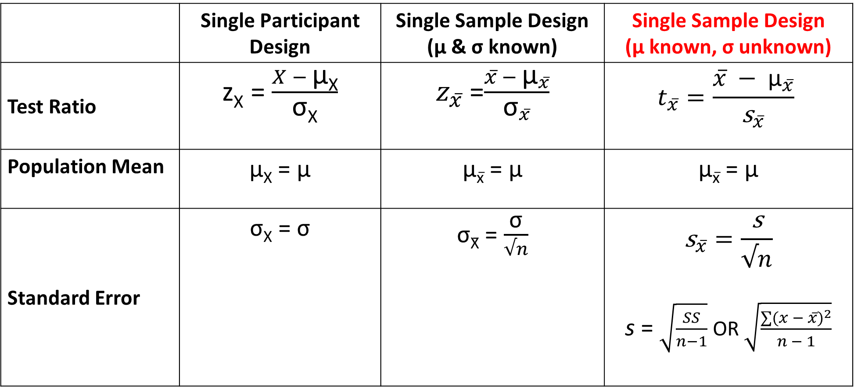
Step 4 - Changes
 | Single Participant Design | Single Sample Design (μ & σ known) | Single Sample Design (μ known, σ unknown)
Test Ratio | z_{X} = $\frac{X − \text{μ}\text{X}}{\text{σ}\text{X}}$ | $z_{x̅}$ =$\frac{x̅ − {\text{μ}}_{x̅}}{{\text{σ}}_{x̅}}$ | $$t_{x̅}=\frac{x̅ − {\text{μ}}_{x̅}}{{\text{s}}_{x̅}}$$
Population Mean | $\text{μ}\text{X}$ = $\text{μ}$ | $\text{μ}\text{x}̅$ = $\text{μ}$ | $\text{μ}\text{x}̅$ = $\text{μ}$
Standard Error | $\text{σ}$_{X} = $\text{σ}$ | $\text{σ}\text{X}\text{̄}$ = $\frac{\text{σ}}{√n}$ | $${\text{s}}_{x̅̅}=\frac{\text{s}}{√n}$$ s = $\sqrt{\frac{SS}{n−1}}$ OR $\sqrt{\frac{∑{(x − x̅)}^{2}}{n − 1}}$

Slide 37
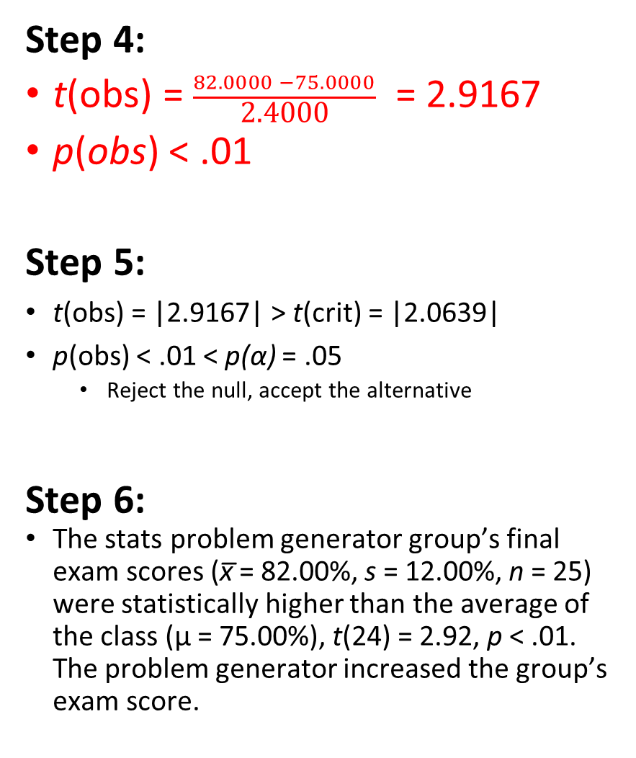
Step 1:
H₀: μ = 75.00
H₁: μ ≠ 75.00
Thus, two-tailed
Step 2:
Type of Research Design: Single-Sample Design
Model of Hypothesis Testing: Random Sampling
Nature of Data (Scales of measurement): Score data
Statistic Being Analyzed: x̅
Information about the Population: μ = 75.00, σ = unknown
Sample Size: n = 25
Shape: Normally distributed
Step 3:
p(α) = .05, t(crit) = 2.0639
Step 4:
t(obs) = $\frac{82.0000 −75.0000}{\text{2.4}\text{00}\text{0}}$ = 2.9167
p(obs) < .01
Step 5:
t(obs) = |2.9167| > t(crit) = |2.0639|
p(obs) < .01 < p(α) = .05
Reject the null, accept the alternative
Step 6:
The stats problem generator group’s final exam scores (x̅ = 82.00%, s = 12.00%, n = 25) were statistically higher than the average of the class (μ = 75.00%), t(24) = 2.92, p < .01. The problem generator increased the group’s exam score.

Slide 38
Step 5 - No Changes
Changes to step 5
No change, but remember the p-values are less specific due to t-table
e.g., p > .10 instead of p = .1223
t(obs) = ___ vs t(crit) = ___
E.g., t(obs) = |2.9167| > t(crit) = |2.0639|
p(obs) ___ vs p(α) = .05
E.g., p(obs) < .01 < p(α) = .05

Slide 39
Step 1:
H₀: μ = 75.00
H₁: μ ≠ 75.00
Thus, two-tailed
Step 2:
Type of Research Design: Single-Sample Design
Model of Hypothesis Testing: Random Sampling
Nature of Data (Scales of measurement): Score data
Statistic Being Analyzed: x̅
Information about the Population: μ = 75.00, σ = unknown
Sample Size: n = 25
Shape: Normally distributed
Step 3:
p(α) = .05, t(crit) = 2.0639
Step 4:
t(obs) = $\frac{82.0000 −75.0000}{\text{2.4}\text{00}\text{0}}$ = 2.9167
p(obs) < .01
Step 5:
t(obs) = |2.9167| > t(crit) = |2.0639|
p(obs) < .01 < p(α) = .05
Reject the null, accept the alternative
Step 6:
The stats problem generator group’s final exam scores (x̅ = 82.00%, s = 12.00%, n = 25) were statistically higher than the average of the class (μ = 75.00%), t(24) = 2.92, p < .01. The problem generator increased the group’s exam score.

Slide 40
Step 6 - Changes
 | Single Participant Design | Single Sample Design (parameters known) | Single Sample Design (σ unknown)
Report | Jo’s final exam score of x = 72% was not statistically different than the average of the class (μ = 90, σ = 10.20), z = -1.76, p = .078. The problem generator did not affect Jo’s exam score. | The stats problem generator groups final exam scores (x̅ = 72%, SD = 1.37, n = 25) were not statistically different than the average of the class (μ = 90, σ = 51.00), z = -1.76, p = .078. The problem generator did not affect the groups exam scores. | The stats problem generator group’s final exam scores (x̅ = 82.00%, s = 12.00%, n = 25) were statistically higher than the average of the class (μ = 75.00%), t(24) = 2.92, p < .01. The problem generator increased the group’s exam score.

Slide 41
Step 1:
H₀: μ = 75.00
H₁: μ ≠ 75.00
Thus, two-tailed
Step 2:
Type of Research Design: Single-Sample Design
Model of Hypothesis Testing: Random Sampling
Nature of Data (Scales of measurement): Score data
Statistic Being Analyzed: x̅
Information about the Population: μ = 75.00, σ = unknown
Sample Size: n = 25
Shape: Normally distributed
Step 3:
p(α) = .05, t(crit) = 2.0639
Step 4:
t(obs) = $\frac{82.0000 −75.0000}{\text{2.4}\text{00}\text{0}}$ = 2.9167
p(obs) < .01
Step 5:
t(obs) = |2.9167| > t(crit) = |2.0639|
p(obs) < .01 < p(α) = .05
Reject the null, accept the alternative
Step 6:
The stats problem generator group’s final exam scores (x̅ = 82.00%, s = 12.00%, n = 25) were statistically higher than the average of the class (μ = 75.00%), t(24) = 2.92, p < .01. The problem generator increased the group’s exam score.

Slide 42
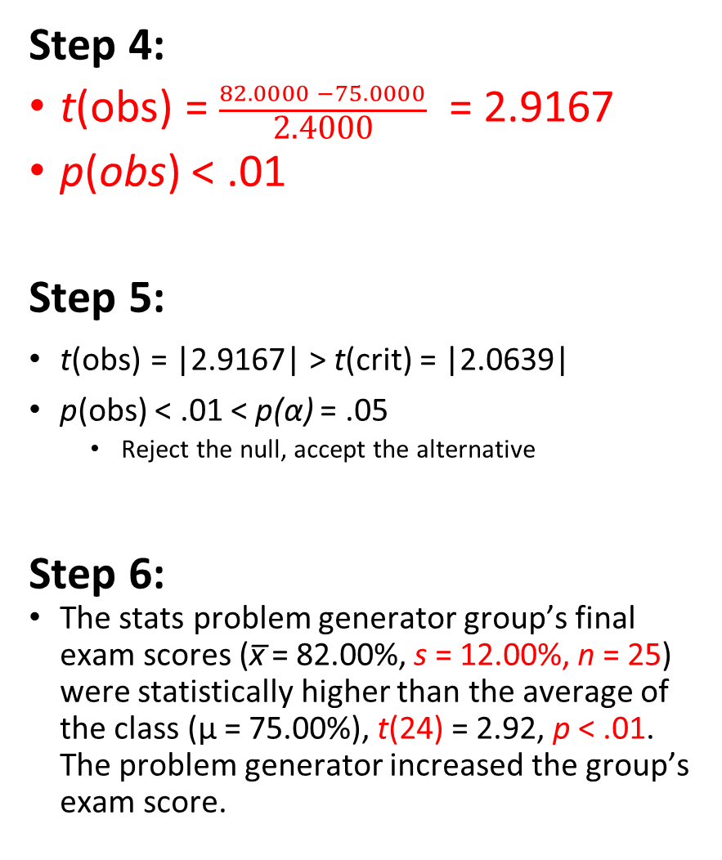
Step 1:
H₀: μ = 75.00
H₁: μ ≠ 75.00
Thus, two-tailed
Step 2:
Type of Research Design: Single-Sample Design
Model of Hypothesis Testing: Random Sampling
Nature of Data (Scales of measurement): Score data
Statistic Being Analyzed: x̅
Information about the Population: μ = 75.00, σ = unknown
Sample Size: n = 25
Shape: Normally distributed
Step 3:
p(α) = .05, t(crit) = 2.0639
Step 4:
t(obs) = $\frac{82.0000 −75.0000}{\text{2.4}\text{00}\text{0}}$ = 2.9167
p(obs) < .01
Step 5:
t(obs) = |2.9167| > t(crit) = |2.0639|
p(obs) < .01 < p(α) = .05
Reject the null, accept the alternative
Step 6:
The stats problem generator group’s final exam scores (x̅ = 82.00%, s = 12.00%, n = 25) were statistically higher than the average of the class (μ = 75.00%), t(24) = 2.92, p < .01. The problem generator increased the group’s exam score.

Slide 43
Lecture Outline
Single Score versus Sample Mean
Single-Sample T-Test
Example

Slide 44

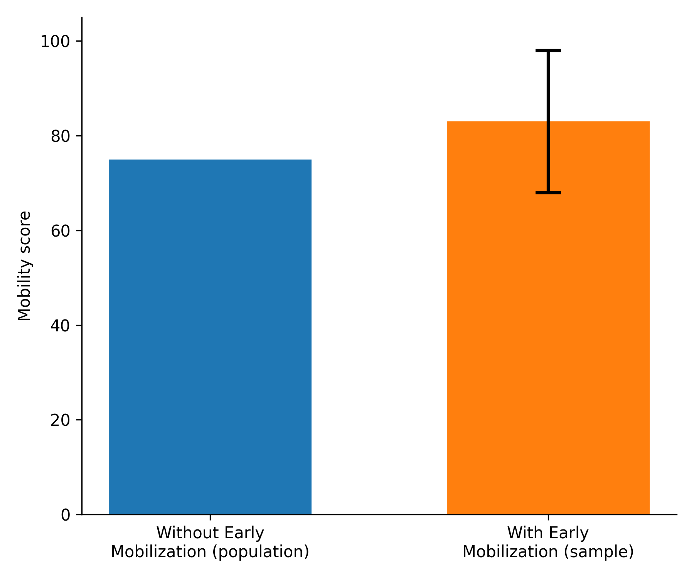
Single Sample Example
Researchers want to help patients recover faster after surgery. They introduce an Early Mobilization Protocol, encouraging patients to get out of bed and start walking within a day of surgery instead of waiting several days. They ask whether this increases patients' 6-week mobility scores compared to the expected average (μ = 75.00). With twenty-five patients following the new protocol, mobility scores had a mean of x̅ = 83.00 and a sum of squares of 5400.00. Did the new protocol increase patients' recovery scores?

Slide 45
Step 1: Define Hypotheses
Researchers want to help patients recover faster after surgery. They introduce an Early Mobilization Protocol, encouraging patients to get out of bed and start walking within a day of surgery instead of waiting several days. They ask whether this increases patients' 6-week mobility scores compared to the expected average (μ = 75.00). With twenty-five patients following the new protocol, mobility scores had a mean of x̅ = 83.00 and a sum of squares of 5400.00. Did the new protocol increase patients' recovery scores?
H₀: μ ≤ 75.00
Mobility scores will be the same or less than the population average
H₁: μ > 75.00
Mobility scores will be higher than the population average

Slide 46
Step 1:
H₀: μ ≤ 75.00
H₁: μ > 75.00
Thus, one-tailed

Slide 47
Step 2: Select Sampling Distribution
Researchers want to help patients recover faster after surgery. They introduce an Early Mobilization Protocol, encouraging patients to get out of bed and start walking within a day of surgery instead of waiting several days. They ask whether this increases patients' 6-week mobility scores compared to the expected average (μ = 75.00). With twenty-five patients following the new protocol, mobility scores had a mean of x̅ = 83.00 and a sum of squares of 5400.00. Did the new protocol increase patients' recovery scores?
Type of Research Design | Single Sample Design (σ unknown)
Model of Hypothesis Testing | Random Sampling
Nature of Data | Score
Statistic Being Analyzed | x̅
Information of Population | μ = 75.00 & σ unknown
Sample Size | n = 25
Shape | Normally Distributed
Sampling Distribution | Sampling Distribution of the Mean for t-scores when df = 24 and σ is unknown

Slide 48
Step 1:
H₀: μ ≤ 75.00
H₁: μ > 75.00
Thus, one-tailed
Step 2:
Type of Research Design: Single-Sample Design
Model of Hypothesis Testing: Random Sampling
Nature of Data (Scales of measurement): Score data
Statistic Being Analyzed: x̅
Information about the Population: μ = 75.00, σ = unknown
Sample Size: n = 25
Shape: Normally distributed

Slide 49
Step 3: Set a priori Criteria
Researchers want to help patients recover faster after surgery. They introduce an Early Mobilization Protocol, encouraging patients to get out of bed and start walking within a day of surgery instead of waiting several days. They ask whether this increases patients' 6-week mobility scores compared to the expected average (μ = 75.00). With twenty-five patients following the new protocol, mobility scores had a mean of x̅ = 83.00 and a sum of squares of 5400.00. Did the new protocol increase patients' recovery scores?
p(α): = .05 (one-tailed)
t(crit): +1.7109

Slide 50
Step 1:
H₀: μ ≤ 75.00
H₁: μ > 75.00
Thus, one-tailed
Step 2:
Type of Research Design: Single-Sample Design
Model of Hypothesis Testing: Random Sampling
Nature of Data (Scales of measurement): Score data
Statistic Being Analyzed: x̅
Information about the Population: μ = 75.00, σ = unknown
Sample Size: n = 25
Shape: Normally distributed
Step 3:
p(α) = .05, t(crit) = 1.7109

Slide 51
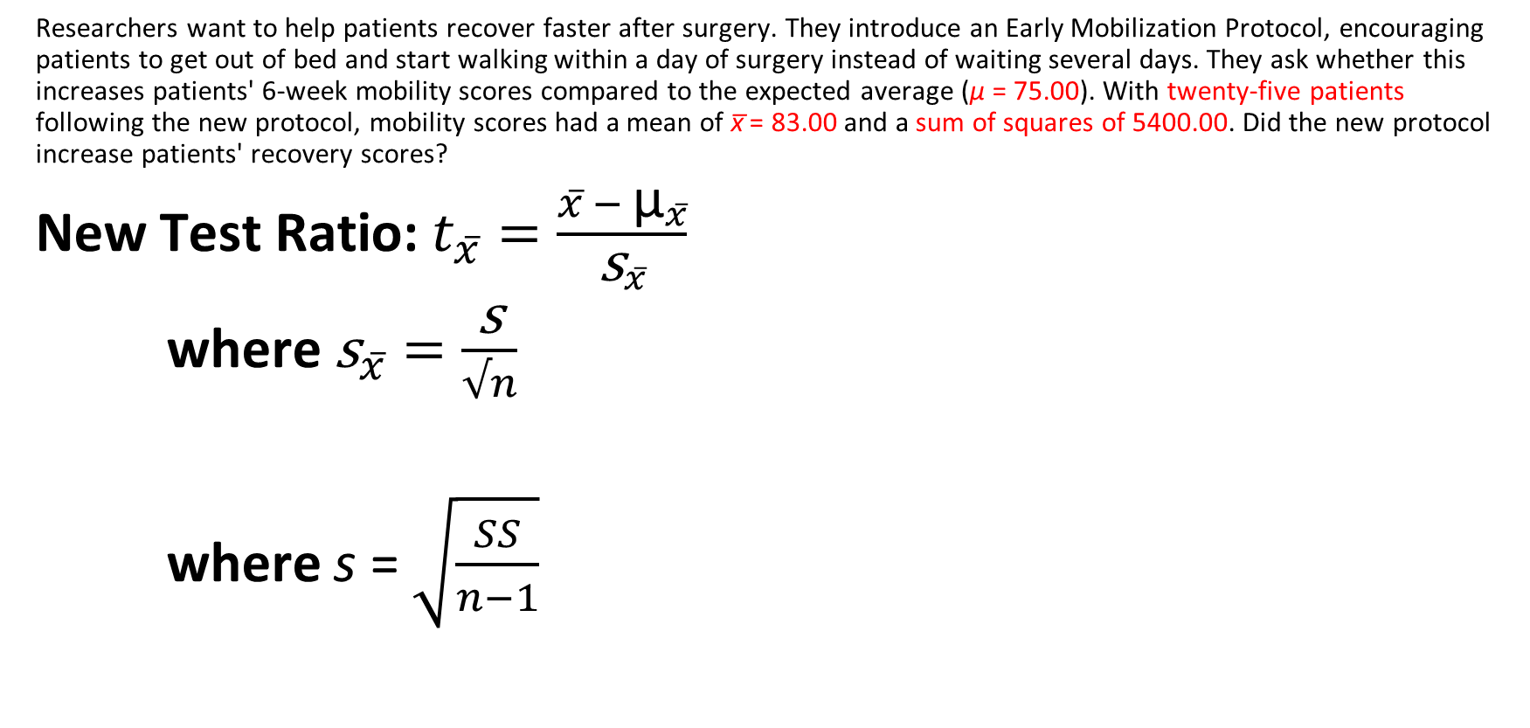
Step 4: Compute Statistics
Researchers want to help patients recover faster after surgery. They introduce an Early Mobilization Protocol, encouraging patients to get out of bed and start walking within a day of surgery instead of waiting several days. They ask whether this increases patients' 6-week mobility scores compared to the expected average (μ = 75.00). With twenty-five patients following the new protocol, mobility scores had a mean of x̅ = 83.00 and a sum of squares of 5400.00. Did the new protocol increase patients' recovery scores?
New Test Ratio: $t_{x̅}=\frac{x̅ − {\text{μ}}_{x̅}}{{\text{s}}_{x̅}}$
where ${\text{s}}_{x̅̅}=\frac{\text{s}}{√n}$
where s = $\sqrt{\frac{SS}{n−1}}$

Slide 52
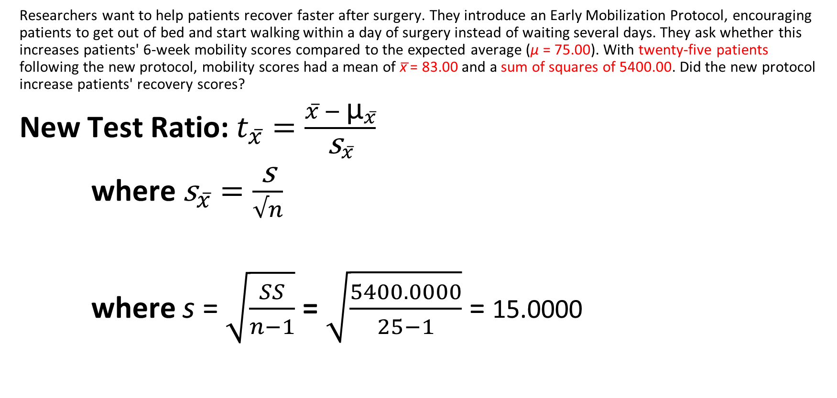
Step 4: Compute Statistics
Researchers want to help patients recover faster after surgery. They introduce an Early Mobilization Protocol, encouraging patients to get out of bed and start walking within a day of surgery instead of waiting several days. They ask whether this increases patients' 6-week mobility scores compared to the expected average (μ = 75.00). With twenty-five patients following the new protocol, mobility scores had a mean of x̅ = 83.00 and a sum of squares of 5400.00. Did the new protocol increase patients' recovery scores?
New Test Ratio: $t_{x̅}=\frac{x̅ − {\text{μ}}_{x̅}}{{\text{s}}_{x̅}}$
where ${\text{s}}_{x̅̅}=\frac{\text{s}}{√n}$
where s = $\sqrt{\frac{SS}{n−1}}$ = $\sqrt{\frac{5400.0000}{25−1}}$ = 15.0000

Slide 53

Step 4: Compute Statistics
Researchers want to help patients recover faster after surgery. They introduce an Early Mobilization Protocol, encouraging patients to get out of bed and start walking within a day of surgery instead of waiting several days. They ask whether this increases patients' 6-week mobility scores compared to the expected average (μ = 75.00). With twenty-five patients following the new protocol, mobility scores had a mean of x̅ = 83.00 and a sum of squares of 5400.00. Did the new protocol increase patients' recovery scores?
New Test Ratio: $t_{x̅}=\frac{x̅ − {\text{μ}}_{x̅}}{{\text{s}}_{x̅}}$
where ${\text{s}}_{x̅̅}=\frac{\text{s}}{√n}$ = $\frac{\text{15.0000}}{√25}$ = 3.0000
where s = $\sqrt{\frac{SS}{n−1}}$ = $\sqrt{\frac{5400.0000}{25−1}}$ = 15.0000

Slide 54
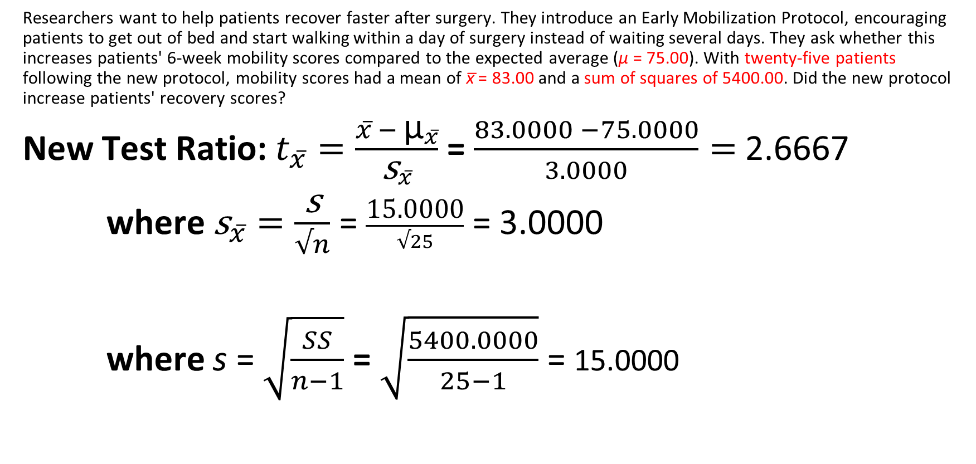
Step 4: Compute Statistics
Researchers want to help patients recover faster after surgery. They introduce an Early Mobilization Protocol, encouraging patients to get out of bed and start walking within a day of surgery instead of waiting several days. They ask whether this increases patients' 6-week mobility scores compared to the expected average (μ = 75.00). With twenty-five patients following the new protocol, mobility scores had a mean of x̅ = 83.00 and a sum of squares of 5400.00. Did the new protocol increase patients' recovery scores?
New Test Ratio: $t_{x̅}=\frac{x̅ − {\text{μ}}_{x̅}}{{\text{s}}_{x̅}}$ = $\frac{83.0000 −75.0000}{3.0000}=$2.6667
where ${\text{s}}_{x̅̅}=\frac{\text{s}}{√n}$ = $\frac{\text{15.0000}}{√25}$ = 3.0000
where s = $\sqrt{\frac{SS}{n−1}}$ = $\sqrt{\frac{5400.0000}{25−1}}$ = 15.0000

Slide 55
Step 4: Compute Statistics
Researchers want to help patients recover faster after surgery. They introduce an Early Mobilization Protocol, encouraging patients to get out of bed and start walking within a day of surgery instead of waiting several days. They ask whether this increases patients' 6-week mobility scores compared to the expected average (μ = 75.00). With twenty-five patients following the new protocol, mobility scores had a mean of x̅ = 83.00 and a sum of squares of 5400.00. Did the new protocol increase patients' recovery scores?
t(obs) = 2.6667
p(obs) < .01
p < .01
p > .005

Slide 56

Step 1:
H₀: μ ≤ 75.00
H₁: μ > 75.00
Thus, one-tailed
Step 2:
Type of Research Design: Single-Sample Design
Model of Hypothesis Testing: Random Sampling
Nature of Data (Scales of measurement): Score data
Statistic Being Analyzed: x̅
Information about the Population: μ = 75.00, σ = unknown
Sample Size: n = 25
Shape: Normally distributed
Step 3:
p(α) = .05, t(crit) = 1.7109
Step 4:
t(obs) = $\frac{83.0000 −75.0000}{\text{3.00}\text{00}}$ = 2.6667
p(obs) < .01

Slide 57
Step 5: Make Statistical Decision
Researchers want to help patients recover faster after surgery. They introduce an Early Mobilization Protocol, encouraging patients to get out of bed and start walking within a day of surgery instead of waiting several days. They ask whether this increases patients' 6-week mobility scores compared to the expected average (μ = 75.00). With twenty-five patients following the new protocol, mobility scores had a mean of x̅ = 83.00 and a sum of squares of 5400.00. Did the new protocol increase patients' recovery scores?
t(obs) = 2.6667 t(crit) = +1.7109
p(obs) < .01 p(α) = .05

Slide 58
Step 5: Make Statistical Decision
Researchers want to help patients recover faster after surgery. They introduce an Early Mobilization Protocol, encouraging patients to get out of bed and start walking within a day of surgery instead of waiting several days. They ask whether this increases patients' 6-week mobility scores compared to the expected average (μ = 75.00). With twenty-five patients following the new protocol, mobility scores had a mean of x̅ = 83.00 and a sum of squares of 5400.00. Did the new protocol increase patients' recovery scores?
t(obs) = 2.6667 > t(crit) = +1.7109
p(obs) < .01 < p(α) = .05
Reject the null hypothesis, accept the alternative hypothesis

Slide 59
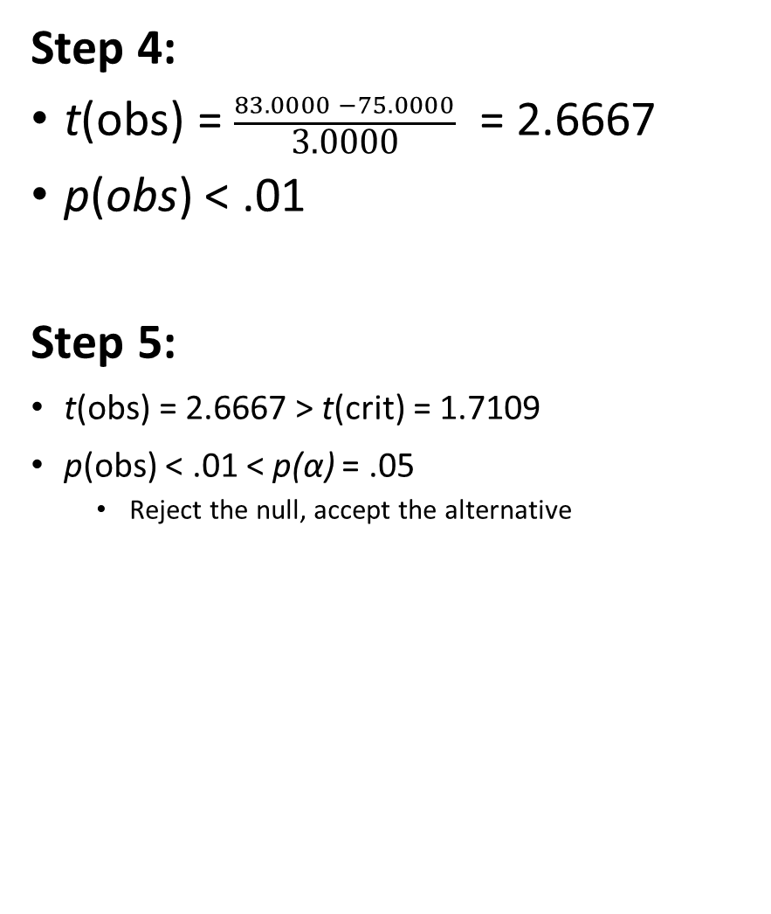
Step 1:
H₀: μ ≤ 75.00
H₁: μ > 75.00
Thus, one-tailed
Step 2:
Type of Research Design: Single-Sample Design
Model of Hypothesis Testing: Random Sampling
Nature of Data (Scales of measurement): Score data
Statistic Being Analyzed: x̅
Information about the Population: μ = 75.00, σ = unknown
Sample Size: n = 25
Shape: Normally distributed
Step 3:
p(α) = .05, t(crit) = 1.7109
Step 4:
t(obs) = $\frac{83.0000 −75.0000}{\text{3.00}\text{00}}$ = 2.6667
p(obs) < .01
Step 5:
t(obs) = 2.6667 > t(crit) = 1.7109
p(obs) < .01 < p(α) = .05
Reject the null, accept the alternative

Slide 60
Step 6: Interpret your Outcome
The Early Mobilization Protocol group’s mobility scores (x̅ = 83.00, s = 15.00, n = 25) were statistically higher than the population average without this protocol (μ = 75.00), t(24)= 2.67, p < .01. The Early Mobilization Protocol increased their mobility scores during recovery.

Slide 61
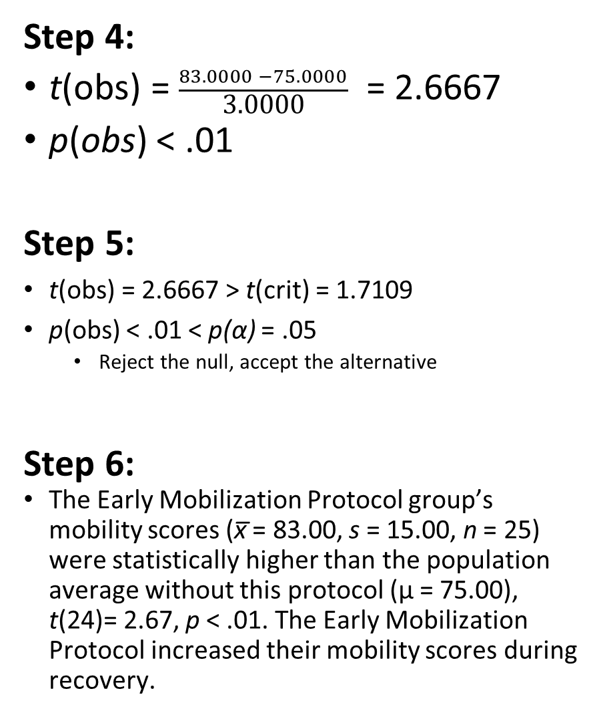
Step 1:
H₀: μ ≤ 75.00
H₁: μ > 75.00
Thus, one-tailed
Step 2:
Type of Research Design: Single-Sample Design
Model of Hypothesis Testing: Random Sampling
Nature of Data (Scales of measurement): Score data
Statistic Being Analyzed: x̅
Information about the Population: μ = 75.00, σ = unknown
Sample Size: n = 25
Shape: Normally distributed
Step 3:
p(α) = .05, t(crit) = 1.7109
Step 4:
t(obs) = $\frac{83.0000 −75.0000}{\text{3.00}\text{00}}$ = 2.6667
p(obs) < .01
Step 5:
t(obs) = 2.6667 > t(crit) = 1.7109
p(obs) < .01 < p(α) = .05
Reject the null, accept the alternative
Step 6:
The Early Mobilization Protocol group’s mobility scores (x̅ = 83.00, s = 15.00, n = 25) were statistically higher than the population average without this protocol (μ = 75.00), t(24)= 2.67, p < .01. The Early Mobilization Protocol increased their mobility scores during recovery.

Slide 62
Extra Resources

Slide 63
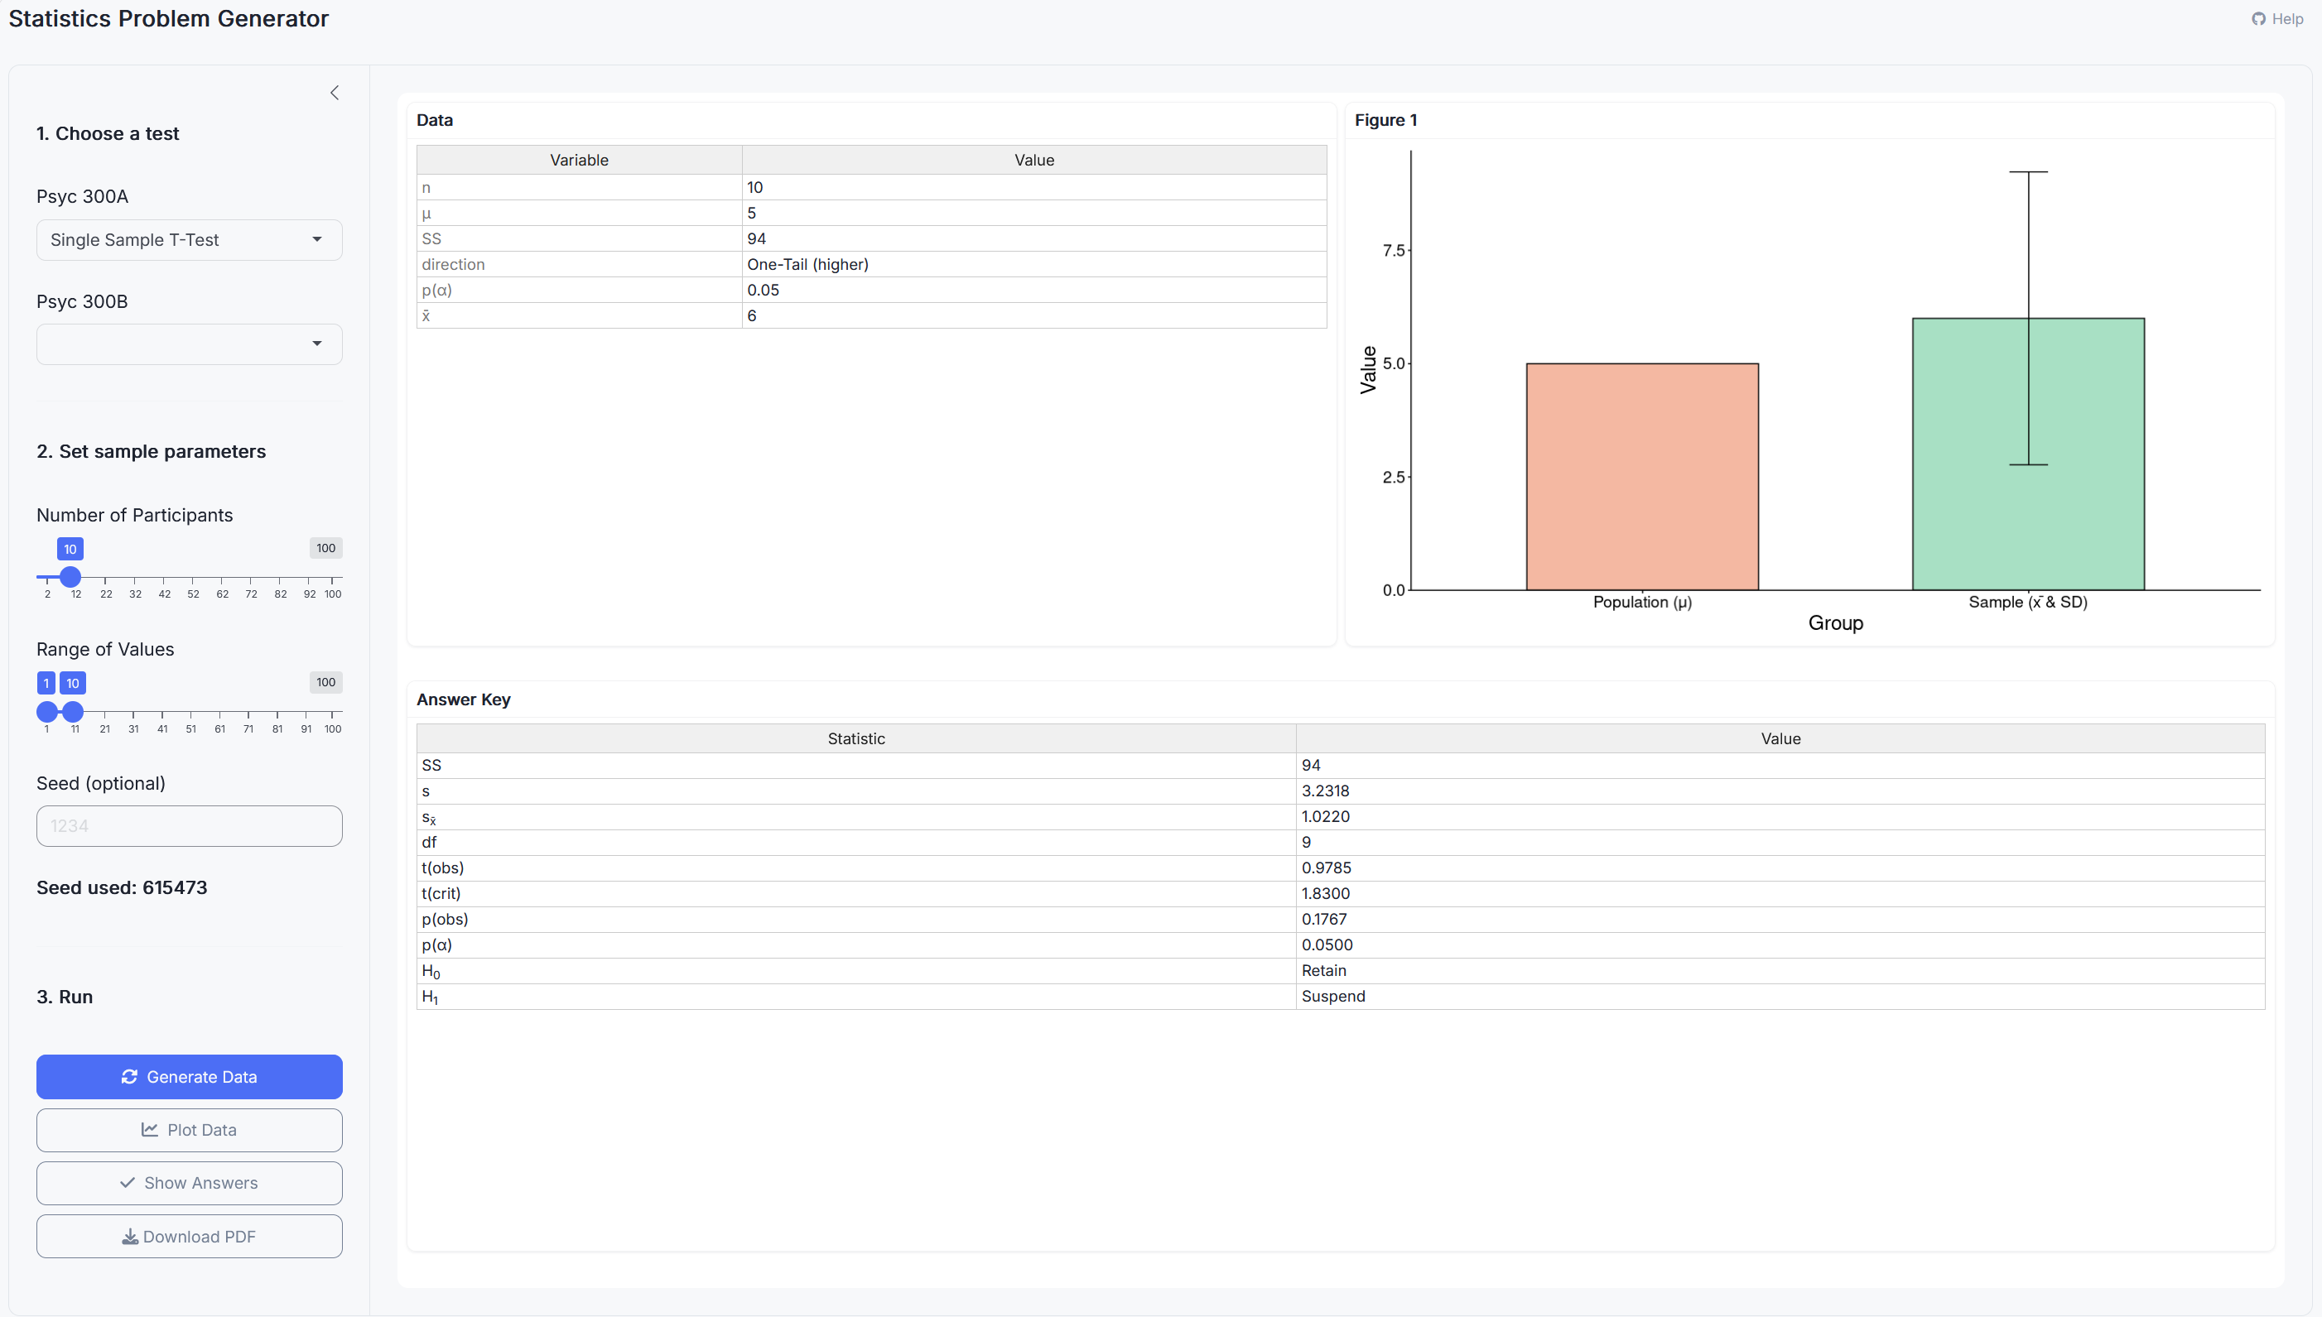
Stats Problem Generator
https://chadcwilliams.shinyapps.io/StatsProblemGenerator/

Slide 64

Extra Resources

